Slide 1
Zigbee
Zigbee is a wireless communication protocol specifically designed for low-power, low-data-rate, and short-range applications. It operates on the IEEE 802.15.4 standard, which defines the physical and media access control (MAC) layers for low-rate wireless personal area networks (WPANs). Here's an explanation of Zigbee's key components and characteristics:
Protocol Stack: Zigbee uses a layered protocol stack similar to the OSI model. It consists of the physical layer (PHY), the MAC layer, the network layer, the application support sublayer (APS), and the application layer.
Low Power Consumption: Zigbee devices are engineered for low-power operation, making them suitable for battery-operated devices and applications where power efficiency is crucial. This allows Zigbee devices to have long battery life, making them suitable for use in wireless sensor networks and home automation systems.
Short Range: Zigbee operates in the 2.4 GHz ISM band and has a typical range of up to 10-100 meters, depending on environmental conditions and power settings. This short-range communication is well-suited for applications like home automation, industrial control, and healthcare monitoring.

Slide 2
Mesh Networking: Zigbee supports mesh networking, allowing devices to relay data through intermediate nodes to extend the network's range and improve reliability. This self-organizing mesh topology enhances network resilience and enables Zigbee networks to cover larger areas.
Low Data Rate: Zigbee is optimized for low-data-rate applications, typically ranging from 20 to 250 kbps. While this may seem slow compared to other wireless protocols like Wi-Fi, it is sufficient for many IoT and sensor-based applications.
Security Features: Zigbee includes built-in security features to protect communication between devices. These features include encryption, authentication, and key management, ensuring the integrity and confidentiality of data transmitted over the network.
Application Profiles: Zigbee defines application profiles that specify how different types of devices communicate with each other within a Zigbee network. These profiles ensure interoperability between devices from different manufacturers and facilitate the development of Zigbee-based solutions.

Slide 3
Overall, Zigbee's combination of low power consumption, short-range communication, mesh networking capabilities, and built-in security features make it a popular choice for various IoT applications, including smart homes, industrial automation, healthcare monitoring, and asset tracking.

Slide 4
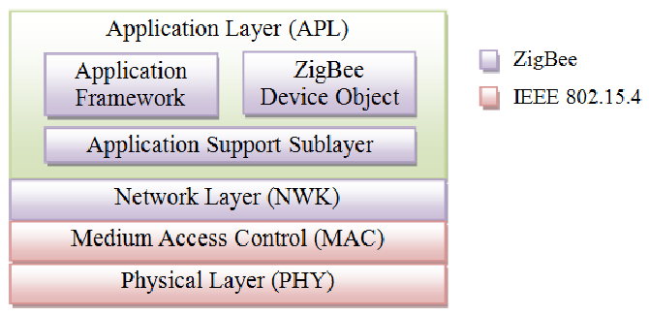
Zigbee Protocol Stack

Slide 5
Physical Layer (PHY)
Defines radio characteristics and modulation techniques.
Handles transmission over the air and energy detection.
Operates in multiple frequency bands (e.g., 2.4 GHz, 915 MHz).
Media Access Control (MAC) Layer
Manages access to the communication medium.
Implements protocols for addressing, acknowledgment, and packet synchronization.
Supports various network topologies and channel access mechanisms.
Network Layer
Responsible for network formation, routing, and addressing.
Facilitates device discovery, joining, and leaving the network.
Supports unicast and multicast communication and efficient routing.

Slide 6
Application Support Sublayer (APS)
Provides services to the application layer.
Handles endpoint addressing, message fragmentation, and reassembly.
Supports application profiles and interaction between application objects.
Application Layer
Defines device functionality and application logic.
Implements device control, data processing, and interaction with higher-level systems.
Interacts with the APS layer to exchange messages and data with other devices.
Interaction between Layers
Each layer interacts with adjacent layers to enable end-to-end communication.
Data flows through the protocol stack from the physical layer to the application layer.
Each layer adds its own headers and metadata to the data packets as they traverse the stack.

